Slide 1
CSC 112: Computer Operating Systems Midterm Exam Spring 2025
Department of Computer Science,
Hofstra University

Slide 2
Q1. Multiple-choice (15 pts)
1. Consider the following functions from positives integers to real numbers (√n denotes SquareRoot(n)): 10, √n, n, log₂n, 100/n.
The correct arrangement of the above functions in increasing order of asymptotic complexity is:
(A) log₂n, 100/n, 10, √n, n
(B) 100/n, 10, log₂n, √n, n
(C) 10, 100/n, √n, log₂n, n
(D) 100/n, log₂n, 10, √n, n
ANS: B
2. Consider the following three functions: f₁ = 10ⁿ f₂ = n^(log n) f₃ = n^(√n)
Which one of the following options arranges the functions in the increasing order of asymptotic complexity?
(A) f₃, f₂, f₁ (B) f₂, f₁, f₃ (C) f₁, f₂, f₃ (D) f₂, f₃, f₁
ANS: D
3. What is the time complexity of function f1(n) and function f2(n), respectively?
void f1(n){
for (int i = 0; i < n; i+=5) {
// O(1)
}
}
void f2(n){
for (int i = 1; i < n; i*=5) {
// O(1)
}
}
A) O(\log n), O(\log n)
B) O(\log n), O(n)
C) O(n), O(\log n)
D) O(n), O(n)
Answer: C
4. What does the regular expression pattern ^[0-9]+$ match?
A) A string containing at least one digit
B) A string starting with a digit
C) A string ending with a digit
D) A string containing only digits
Answer: D
5. Which of the following regular expressions matches exactly three consecutive lowercase letters?
A) [a-z]{3}
B) [a-z]{1,3}
C) [a-z]{3,}
D) [a-z]{0,3}
Answer: A
6. What does the regular expression [^abc] match?
A) Either a, b, or c
B) Any character that is not a, b, or c
C) The beginning of a string followed by a, b, or c
D) The characters 'a', 'b', and 'c' only when they appear together
Answer: B
7. Which regular expression correctly matches a valid email address format (username@domain.com)?
A) [a-zA-Z0-9]+@[a-zA-Z0-9]+.[a-zA-Z]{2,}
B) [a-zA-Z0-9]@[a-zA-Z0-9].[a-zA-Z]
C) [a-zA-Z0-9]@[a-zA-Z0-9].[a-zA-Z]*
D) .+@.+..+
Answer: A
8. Which regular expression matches a string that contains either "cat" or "dog"?
A) cat|dog
B) (cat)(dog)
C) cat+dog
D) [cat|dog]
Answer: A
9. Which of the following would match a string containing at least one digit?
A) \d+
B) \d{1,}
C) \d?
D) Both A and B
Answer: D
10. What does the regular expression \b[A-Z][a-z]*\b match?
A) Any capitalized word (a word that starts with an uppercase letter followed by zero or more lowercase letters)
B) Any word containing at least one uppercase letter in it
C) Any word written entirely in uppercase
D) Any word with exactly one uppercase letter in it
Answer: A

Slide 3
Q1. Multiple-choice (15 pts)
11. Which of the following is NOT a necessary condition for deadlock?
A) Mutual exclusion
B) Hold and wait
C) No preemption
D) Fair Scheduling
Answer: D
12. In a Resource-Allocation Graph (RAG), a deadlock is certain if:
A) There is a cycle and each resource has multiple instances
B) There is no cycle
C) There is a cycle and all resources have single instances
D) A thread requests two resources simultaneously
Answer: C
13. In the context of the Dining Philosophers problem, which solution can prevent deadlock?
A) Allowing each philosopher to pick up forks in any order
B) Requiring each philosopher to pick up both forks simultaneously in one atomic operation
C) Requiring each philosopher to pick up his left fork before his right fork
D) Removing all forks from the table
Answer: B
14. In the context of the two-armed lawyers problem, where there is a pile of chopsticks at the center of the table, wher which solution can prevent deadlock?
A) Allowing each lawyer to pick up chopsticks in any order
B) Requiring each lawyer to pick up both chopsticks simultaneously in one atomic operation
C) Requiring each lawyer to pick up his left chopstick before his right chopstick
D) Removing all chopsticks from the table
Answer: B
15. In the producer-consumer problem, why must the mutex be acquired after sem_wait(emptySlots)?
A) To prevent buffer overflow
B) To avoid deadlock
C) To ensure proper scheduling
D) To maintain thread priority
Answer: B

Slide 4
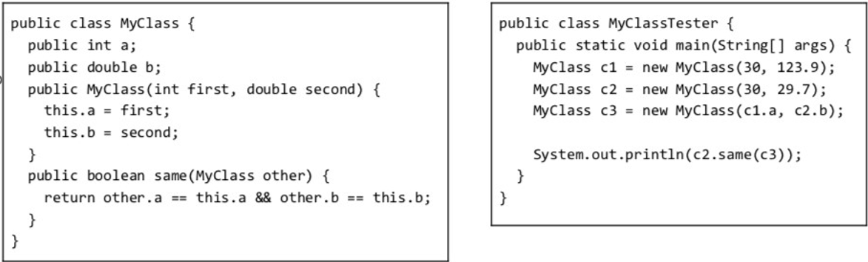
Q2 Lecture 3-inheritance and polymorphism
a) (1 pts) What does the main method of MyClass Tester print?
ANS: true, since both c2 and c3 have member variables a=30 and b=29.7

Slide 5
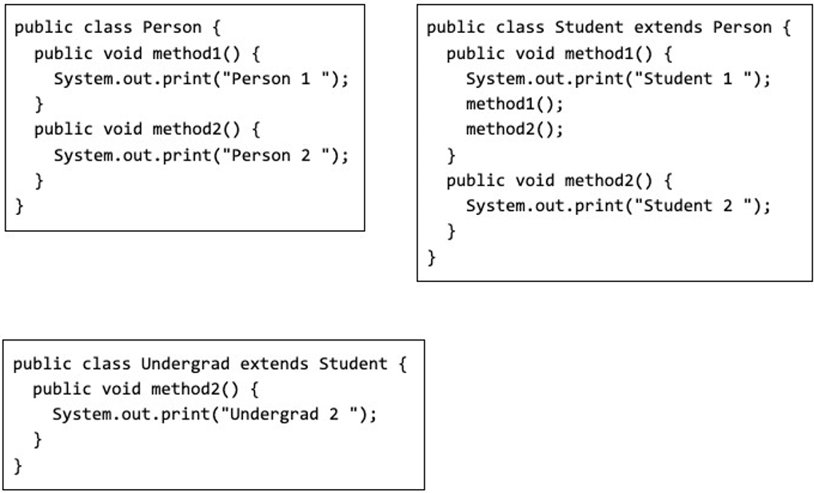
Q2 Lecture 3-inheritance and polymorphism
b) (4 pts) Consider the following class definitions:
b1) What does the following program print? Explain why.
ANS: Infinite recursive calling of method1() to print “Student 1” repeatedly. Since the actual object type is Undergrad, but method1() is not defined in class Undergrad, so the method1() defined its parent class will be called to print “Student 1” in an infinite recursion.
b2) What does the following program print? Explain why.
ANS: It prints “Undergrad 2”. Since the actual object type is Undergrad, the method2() defined in class Undergrad will be called to print “Undergrad 2”.
Person u = new Undergrad();
u.method1();
Person u = new Undergrad();
u.method2();

Slide 6
Q3. Lecture 5-algorithm performance analysis (10 pts)
For each function f(n) below, give an asymptotic upper bound using big-O notation. You should give the tightest bound possible (so giving O(2^{n}) for every question is unlikely to result in many points).
f(n) = 1000000
f(n) = n⁴ +100n³ +14n²
f(n) = 2^{n} +100n³ +14n²
f(n) = 100n³ + 14n²
f(n) = 7n² + 14n
f(n) = log(7n²)
f(n) = 5loglogn + 4log(n)*log(n)
f(n) = .001n + 100*2^{n}
f(n) = n³(1 + 6n + 2014n²)
f(n) = (logn)(n + n²)
O(1)
O(n⁴)
O(2^{n})
O(n³)
O(n²)
O(logn)
O(log² n)
O(2^{n})
O(n⁵)
O(n² logn)

Slide 7
Q4. Lecture 7-hash table (20 pts)
Insert the following six keys in this order: 19, 48, 8, 27, 97, 7 into a hash table of size 10, where the hash function is modulo table size (%10).
a) (1 pts) What is the load factor?
ANS: Load factor = number of keys / size of hash table = 6/10 = 0.6
b) (3 pts) Fill in the table, resolving hash collisions with linear probing. (Fill in the table without detailed steps.)
ANS:
19 (insert at index 9)
48 (insert at index 8)
8 (collision with 48). Insert at index 0
27 (insert at index 7)
97 (collision with 27). Insert at index 1
7 (collision with 27). Insert at index 2
0 | 1 | 2 | 3 | 4 | 5 | 6 | 7 | 8 | 9
8 | 97 | 7 |  |  |  |  | 27 | 48 | 19

Slide 8
Q4. Lecture 7-hash table (20 pts)
c) (4 pts) Fill in the table, resolving hash collisions with quadratic probing. (Show the probe sequence for resolving collisions.)
ANS:
19 (insert at index 9)
48 (insert at index 8)
8 (collision with 48 at index 8)
(8 + 1^2) % 10 = 9 (collision with 19)
(8 + 2^2) % 10 = 2. Insert at index 2
27 (insert at index 7)
97 (collision with 27 at index 7)
(7 + 1^2) % 10 = 8 (collision with 48)
(7 + 2^2) % 10 = 1 (empty). Insert at index 1
7 (collision with 27 at index 7)
(7 + 1^2) % 10 = 8 (collision with 48)
(7 + 2^2) % 10 = 1 (collision with 97)
(7 + 3^2) % 10 = 6 (empty). Insert at index 6
0 | 1 | 2 | 3 | 4 | 5 | 6 | 7 | 8 | 9
 | 97 | 8 |  |  |  | 7 | 27 | 48 | 19

Slide 9
Q4. Lecture 7-hash table (20 pts)
d) (8 pts) Fill in the table, resolving hash collisions with double hashing with two hash functions:
h1(k)=x%10 (primary hash), h2(k)=1+(x%7) (secondary hash), Probing formula:
Probe(k, i)=(h1(k)+i⋅h2(k))%10, i=0, 1, 2… (Show the probe sequence for resolving collisions.)
19 (insert at index 9)
48 (insert at index 8)
8 (collision with 48 at index 8)
h₂(8)=1+(8%7)=2. Next probe: (8 + 1·2)%10 = 0 (insert at index 0)
27 (insert at index 7)
97 (collision with 27 at index 7)
h₂(97)=1+(97%7)=7. Next probe: (7 + 1·7)%10 = 4 (insert at index 4)
7 (collision with 27 at index 7)
h₂(7)=1+(7%7)=1. Next probes:
i=1: (7 + 1·1)%10 = 8 (collision with 48)
i=2: (7 + 2·1)%10 = 9 (collision with 19)
i=3: (7 + 3·1)%10 = 0 (collision with 8)
i=4: (7 + 4·1)%10 = 1 (insert at index 1)
0 | 1 | 2 | 3 | 4 | 5 | 6 | 7 | 8 | 9
8 | 7 |  |  | 97 |  |  | 27 | 48 | 19

Slide 10
Q4. Lecture 7-hash table (20 pts) (with typo)
(The exam paper had a typo Probe(k, i)=(h1(k)+i⋅h2(k))%7. Despite this typo, it is still a valid hash function and you can still solve this problem based on this probe function. Students who give either solution is given full credit.)
d) (8 pts) Fill in the table, resolving hash collisions with double hashing with two hash functions:
h1(k)=x%10 (primary hash), h2(k)=1+(x%7) (secondary hash), Probing formula:
Probe(k, i)=(h1(k)+i⋅h2(k))%7, i=0, 1, 2… (Show the probe sequence for resolving collisions.)
19 (insert at index 9)
48 (insert at index 8)
8 (collision with 48 at index 8)
h₂(8)=1+(8%7)=2. Next probe: (8 + 1·2)%7 = 3 (insert at index 3)
27 (insert at index 7)
97 (collision with 27 at index 7)
h₂(97)=1+(97%7)=7. Next probe: (7 + 1·7)%7 = 0 (insert at index 0)
7 (collision with 27 at index 7)
h₂(7)=1+(7%7)=1. Next probe: (7 + 1·1)%7 = 1 (insert at index 1)
0 | 1 | 2 | 3 | 4 | 5 | 6 | 7 | 8 | 9
97 | 7 |  | 8 |  |  |  | 27 | 48 | 19

Slide 11
Q4: Separate Chaining
e) (2 pts) Fill in the table, resolving hash collisions with separate chaining into a sorted linked list (with the smallest element at the head of the list). (Fill in the table without detailed steps.)
ANS: Upon hash collision, put the item into a sorted linked list in the index.
0 | 1 | 2 | 3 | 4 | 5 | 6 | 7 | 8 | 9
 |  |  |  |  |  |  | 7,27,97 | 8,48 | 19

Slide 12
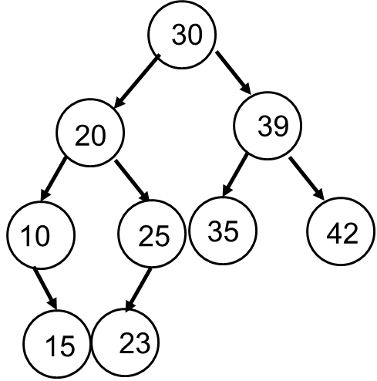
Q5. Lecture 8-binary search tree (40 pts)
a) (15 pts) The Pre-order traversal sequence of a Binary Search Tree is 30, 20, 10, 15, 25, 23, 39, 35, 42. Construct the tree and give its in-order and post-order traversals. Show the detailed steps.
ANS: Given:
Pre-order: 30 20 10 15 25 23 39 35 42
In-order: 10 15 20 23 25 30 35 39 42
We can construct the tree and derive the post-order
Post-order: 15 10 23 25 20 35 42 39 30

Slide 13
Q5. Lecture 8-binary search tree (40 pts)
a) Explanations:
Pre-order: 30 20 10 15 25 23 39 35 42
In-order: 10 15 20 23 25 30 35 39 42
1. Root Identification: The first element in pre-order (30) is the root.
2. Subtree Division:
- In in-order traversal, elements before 30 (10 15 20 23 25) form the left subtree, and elements after (35 39 42) form the right subtree.
3. Left Subtree Construction:
- Pre-order segment for left: 20 10 15 25 23
- Root is 20 (first in pre-order). In in-order (10 15 20 23 25), left of 20 is (10 15) and right is (23 25).
- Pre-order segment (10 15): root is 10, and 15 is its right child
- Pre-order segment (25 23): root is 25, and 23 is its right child
4. Right Subtree Construction:
- Pre-order segment for right: (39 35 42)
- Root is 39 (first in pre-order). In in-order (35 39 42), 39 has a left child 35 and right child 42.
We can draw the tree now and derive the post order traversal 15 10 23 25 20 35 42 39 30.

Slide 14
Q5. Lecture 8-binary search tree (40 pts)
b) (5 pts) Given this Binary Search Tree, draw the resulting Binary Search Tree after deleting node 15. There are two possible results, and please draw both of them.
20
20
20
15
30
30
16
30
Delete 15
12
OR
10
17
10
17
10
17
2
12
16
19
2
16
19
2
12
19

Slide 15
Q5. Lecture 8-binary search tree (40 pts)
c) (20 pts) Fill in the labels A, B, C in each node in the following Binary Trees so they all have:
either (1) pre-order traversal of ABC
or (2) In-order traversal of ABC
or (3) post-order traversal of ABC
or (4) they are all Binary Search Trees, considering A < B < C

Slide 16
(1) pre-order traversal of ABC
A
A
A
A
A
B
B
B
B
B
C
C
C
C
C

Slide 17
(2) In-order traversal of ABC
A
C
A
C
B
C
B
B
A
A
C
B
A
C
B

Slide 18
(3) post-order traversal of ABC
C
C
C
C
C
B
B
B
B
A
B
A
A
A
A

Slide 19
(4) they are all Binary Search Trees, considering A < B < C
A
C
A
C
B
C
B
B
A
A
C
B
A
C
B

Slide 20
Q6 Lecture 9-self balancing trees (20 pts)
a) (10 pts) Create an AVL Tree by inserting the sequence: 6, 5, 4, 3, 2, 1, 0. Draw a new figure whenever you do a rotation. (Do not write out the AVL invariant at each step, just draw the tree at each step.) (If you run out of space, use back of the paper.)

Slide 21
AVL Tree: Inserting the sequence: 6, 5, 4, 3, 2, 1, 0
5
6
5
Insert 6,5,4
Right rotation
Insert 3,2
4
6
5
4
6
4
3
2
5
5
Right rotation
(5 is lowest unbalanced node.)
Right Rotation
Insert 1
3
3
6
6
3
2
5
2
4
4
2
1
4
6
1

Slide 22
AVL Tree: Inserting the sequence: 6, 5, 4, 3, 2, 1, 0
3
3
Right rotation
(2 is lowest unbalanced node.)
Insert 0
1
5
2
5
0
2
4
6
1
4
6
0

Slide 23
Q6 Lecture 9-self balancing trees (20 pts)
b) (10 pts) Create a Red-Black Tree by inserting the sequence: 6, 5, 4, 3, 2, 1, 0. Draw a new figure whenever you do a rotation and/or recoloring. (If you run out of space, use back of the paper.)
Notes:
This is the kink case

Slide 24
Red-Black Tree: Inserting the sequence: 6, 5, 4, 3, 2, 1, 0
5
6
Right rotation
Recolor
5
Insert 6,5,4
Insert 3
4
6
5
4
6
4
3
5
5
5
Right rotation
Recolor
5
Recolor
Recolor
Insert 2
4
6
6
6
6
4
4
3
3
3
3
2
4
2

Slide 25
Red-Black Tree: Inserting the sequence: 6, 5, 4, 3, 2, 1, 0
5
5
5
5
Insert 1
Recolor
Insert 0
3
6
3
6
3
6
3
6
2
4
2
4
2
4
2
4
5
Right rotation
Recolor
1
1
1
3
6
0
1
4
0
2

Slide 26
Red-Black Tree: Inserting the sequence: 1,2,3,4,5,6
1
Left rotation
Recolor
2
2
Insert 1,2,3
2
Insert 4
1
3
1
3
3
4
2
2
2
2
Left rotation
Recolor
Recolor
Recolor
Insert 5
1
4
3
3
1
3
1
1
3
5
4
4
4
5

